Slide 1
Computer Arithmetic

Slide 2
Arithmetic & Logic Unit
Does the calculations
Everything else in the computer is there to service this unit
Handles integers
May handle floating point (real) numbers
May be separate FPU (maths co-processor)
May be on chip separate FPU (486DX +)

Slide 3
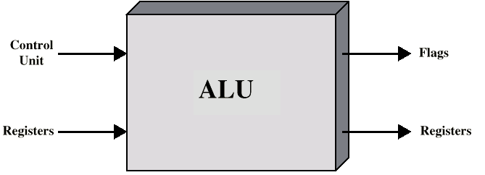
ALU Inputs and Outputs

Slide 4
Conversion Between Lengths
Signed Extension
Positive number pack with leading zeros
+18 = 00010010
+18 = 00000000 00010010
Negative numbers pack with leading ones
-18 = 10010010
-18 = 11111111 10010010
i.e. pack with MSB (sign bit)

Slide 5
Addition and Subtraction
Normal binary addition
Monitor sign bit for overflow
Take twos compliment of substahend and add to minuend
  i.e. a - b = a + (-b)
So we only need addition and complement circuits

Slide 6
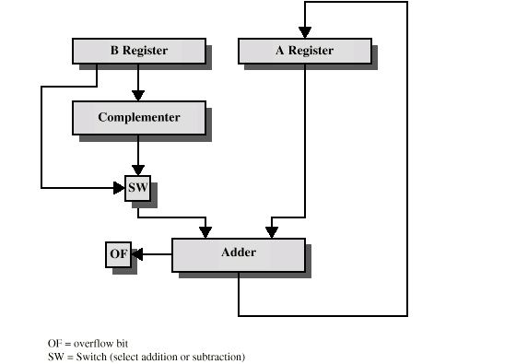
Hardware for Addition and Subtraction

Slide 7
Multiplication
Complex
Work out partial product for each digit
Take care with place value (column)
Add partial products

Slide 8
Multiplication Example
1011 Multiplicand (11 dec)
x 1101 Multiplier (13 dec)
1011 Partial products
0000 Note: if multiplier bit is 1 copy
1011 multiplicand (place value)
1011 otherwise zero
10001111 Product (143 dec)
Note: need double length result

Slide 9
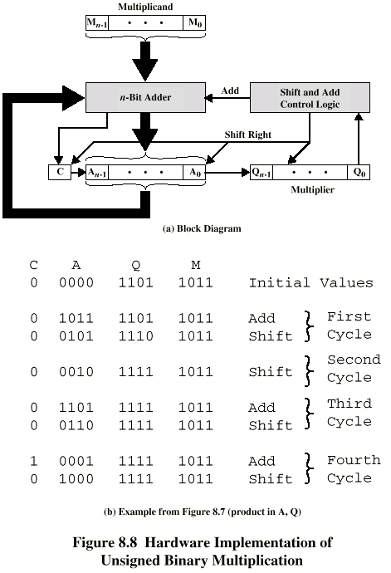
Unsigned Binary Multiplication

Slide 10
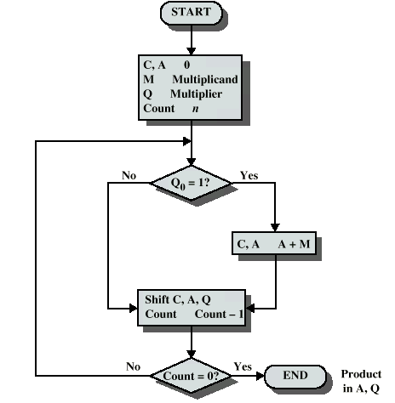
Flowchart for Unsigned Binary Multiplication
Simple Right Shift
0 0 0 0 1 1 1 0
0 0 0 0 0 1 1 1
1 0 0 0 1 1 1 0
0 1 0 0 0 1 1 1

Slide 11
Execution of Example

Slide 12
Multiplying Negative Numbers
This does not work!
Solution 1
  Convert to positive if required
  Multiply as above
  If signs were different, negate answer
Solution 2
  Booth’s algorithm

Slide 13
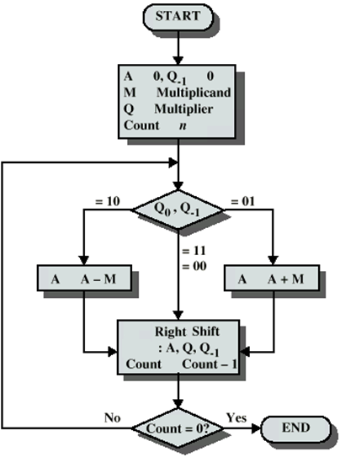
Booth’s Algorithm with simple Right Shift

Slide 14
Example of Booth’s Algorithm
(-4*3)
 |  | Mc |  | Mp
 |  | -4 | * | 3 |  |  |  |  |  |  |  | M |  | 1100
 |  | M |  | Q |  |  |  |  |  |  |  | –M |  | 0100
Counter | A |  |  |  | Q |  |  |  |  | Operation |  | Mc | : | Multiplicand (M)
 |  |  |  |  | Q₃ | Q₂ | Q₁ | Q₀ | Q₋₁ |  |  | Mp | : | Multiplier (Q)
4 | 0 | 0 | 0 | 0 | 0 | 0 | 1 | 1 | 0 | Initialization |  | SRS | : | Simple Right Shift
 | 0 | 1 | 0 | 0 | 0 | 0 | 1 | 1 | 0 | A=A-M |  | CD | : | Counter Decrement
 | 0 | 0 | 1 | 0 | 0 | 0 | 0 | 1 | 1 | SRS
3 | 0 | 0 | 1 | 0 | 0 | 0 | 0 | 1 | 1 | CD
 | 0 | 0 | 0 | 1 | 0 | 0 | 0 | 0 | 1 | SRS
2 | 0 | 0 | 0 | 1 | 0 | 0 | 0 | 0 | 1 | CD
 | 1 | 1 | 0 | 1 | 0 | 0 | 0 | 0 | 1 | A=A+M
 | 0 | 1 | 1 | 0 | 1 | 0 | 0 | 0 | 0 | SRS
1 | 0 | 1 | 1 | 0 | 1 | 0 | 0 | 0 | 0 | CD
 | 0 | 0 | 1 | 1 | 0 | 1 | 0 | 0 | 0 | SRS
0 | 0 | 0 | 1 | 1 | 0 | 1 | 0 | 0 | 0 | CD
 |  |  |  |  |  |  |  |  |  | STOP

Slide 15
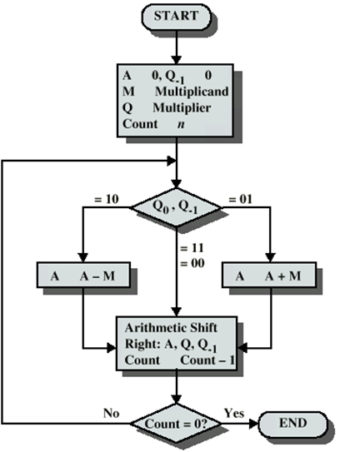
Booth’s Algorithm using Arithmetic Right Shift
Use Simple Right Shift
OR
Arithmetic Right Shift
0 0 0 0 1 1 1 0
0 0 0 0 0 1 1 1
1 0 0 0 1 1 1 0
1 1 0 0 0 1 1 1
Reason: Sign extension in 2’s Complement
Note: You can get Answer using both shift..
But simple right shift will need some manipulation in answer in the end

Slide 16
Example of Booth’s Algorithm using ARS
(7*3)
 |  | Mc |  | Mp
 |  | 7 | * | 3 |  |  |  |  |  |  |  | M |  | 0111
 |  | M |  | Q |  |  |  |  |  |  |  | –M |  | 1001
Counter | A |  |  |  | Q |  |  |  |  | Operation |  | Mc | : | Multiplicand (M)
 |  |  |  |  | Q₃ | Q₂ | Q₁ | Q₀ | Q₋₁ |  |  | Mp | : | Multiplier (Q)
4 | 0 | 0 | 0 | 0 | 0 | 0 | 1 | 1 | 0 | Initialization |  | ARS | : | Arithmetic Right Shift
 | 1 | 0 | 0 | 1 | 0 | 0 | 1 | 1 | 0 | A= A-M |  | CD | : | Counter Decrement
 | 1 | 1 | 0 | 0 | 1 | 0 | 0 | 1 | 1 | ARS |  | AQ | : | Answer
3 | 1 | 1 | 0 | 0 | 1 | 0 | 0 | 1 | 1 | CD
 | 1 | 1 | 1 | 0 | 0 | 1 | 0 | 0 | 1 | ARS
2 | 1 | 1 | 1 | 0 | 0 | 1 | 0 | 0 | 1 | CD
 | 0 | 1 | 0 | 1 | 0 | 1 | 0 | 0 | 1 | A= A+M
 | 0 | 0 | 1 | 0 | 1 | 0 | 1 | 0 | 0 | ARS
1 | 0 | 0 | 1 | 0 | 1 | 0 | 1 | 0 | 0 | CD
 | 0 | 0 | 0 | 1 | 0 | 1 | 0 | 1 | 0 | ARS
0 | 0 | 0 | 0 | 1 | 0 | 1 | 0 | 1 | 0 | CD
 |  |  |  |  |  |  |  |  |  | STOP

Slide 17
Example of Booth’s Algorithm using ARS
(-7*3)
 |  | Mc |  | Mp
 |  | -7 | * | 3 |  |  |  |  |  |  |  | M |  | 1001
 |  | M |  | Q |  |  |  |  |  |  |  | –M |  | 0111
Counter | A |  |  |  | Q |  |  |  |  | Operation |  | Mc | : | Multiplicand (M)
 |  |  |  |  | Q₃ | Q₂ | Q₁ | Q₀ | Q₋₁ |  |  | Mp | : | Multiplier (Q)
4 | 0 | 0 | 0 | 0 | 0 | 0 | 1 | 1 | 0 | Initialization |  | ARS | : | Arithmetic Right Shift
 | 0 | 1 | 1 | 1 | 0 | 0 | 1 | 1 | 0 | A=A-M |  | CD | : | Counter Decrement
 | 0 | 0 | 1 | 1 | 1 | 0 | 0 | 1 | 1 | ARS |  | AQ | : | Answer
3 | 0 | 0 | 1 | 1 | 1 | 0 | 0 | 1 | 1 | CD
 | 0 | 0 | 0 | 1 | 1 | 1 | 0 | 0 | 1 | ARS
2 | 0 | 0 | 0 | 1 | 1 | 1 | 0 | 0 | 1 | CD
 | 1 | 0 | 1 | 0 | 1 | 1 | 0 | 0 | 1 | A=A+M
 | 1 | 1 | 0 | 1 | 0 | 1 | 1 | 0 | 0 | ARS
1 | 1 | 1 | 0 | 1 | 0 | 1 | 1 | 0 | 0 | CD
 | 1 | 1 | 1 | 0 | 1 | 0 | 1 | 1 | 0 | ARS
0 | 1 | 1 | 1 | 0 | 1 | 0 | 1 | 1 | 0 | CD
 |  |  |  |  |  |  |  |  |  | STOP

Slide 18
Division
More complex than multiplication
Negative numbers are really bad!
Based on long division

Slide 19
Division of Unsigned Binary Integers
Quotient
(00001101 8-Bit)
1101
Divisor
1011
10010011
Dividend
1011
001110
Partial
Remainders
1011
001111
1011
Remainder
100

Slide 20
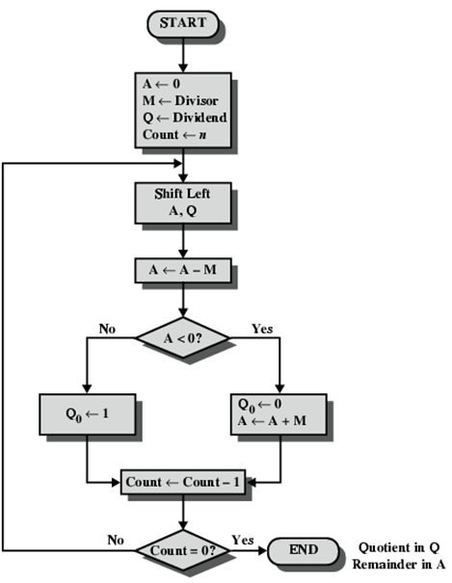
Flowchart for Unsigned Binary Division

Slide 21
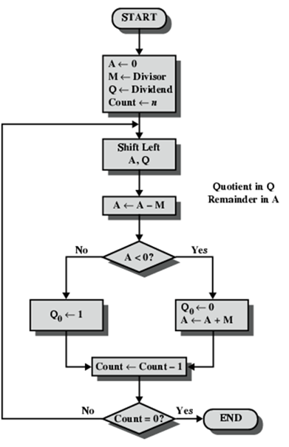
Binary Division: Example
Dividend (Q) = 11, Devisor(M) = 3
-------------------------------------------------------------------
n M A Q Operation
-------------------------------------------------------------------
4 0011 0000 1011 initialize
0011 0001 011_ shift left AQ
0011 1110 011_ A=A-M (Using 2’s Compl)
0011 0001 0110 Q[0]=0 and
Restore A i.e. A=A+M
3 0011 0010 110_ shift left AQ
0011 1111 110_ A=A-M
0011 0010 1100 Q[0]=0, Restore A
2 0011 0101 100_ shift left AQ
0011 0010 100_ A=A-M
0011 0010 1001 Q[0]=1
1 0011 0101 001_ shift left AQ
0011 0010 001_ A=A-M
0011 0010 0011 Q[0]=1

Slide 22
Problem
2 / 2
4 / 2

Slide 23
Division of signed numbers
Use previously taught division algorithm and adjust sign later

Slide 24
Real Numbers
Numbers with fractions
Could be done in pure binary
  1001.1010 = 2⁴ + 2⁰ +2⁻¹ + 2⁻³ =9.625
Where is the binary point?
Fixed?
  Very limited
Moving?
  How do you show where it is?

Slide 25
Floating Point
Sign bit
Biased
Exponent
Significand or Mantissa
+/- .significand x 2^{exponent}
Misnomer
Point is actually fixed between sign bit and body of mantissa
Exponent indicates place value (point position)

Slide 26
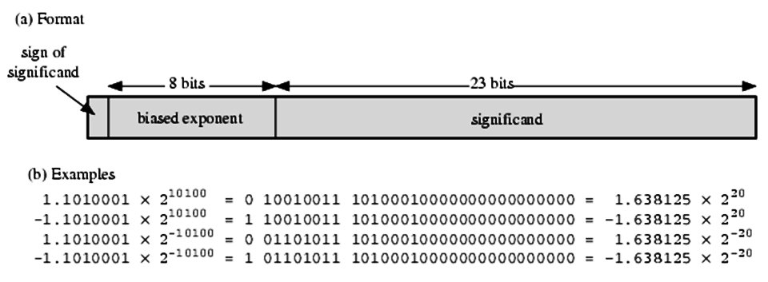
Floating Point Examples
1 0 1 0 0 20
0 1 1 1 1 1 1 1 + 127
------------------------------------------
1 0 0 1 0 0 1 1

Slide 27
Signs for Floating Point
Mantissa is stored in 2s compliment
Exponent is in excess or biased notation
  e.g. Excess (bias) 128 means
  8 bit exponent field
  Pure value range 0-255
  Subtract 128 to get correct value
  Range -128 to +127

Slide 28
Normalization
FP numbers are usually normalized
i.e. exponent is adjusted so that leading bit (MSB) of mantissa is 1
Since it is always 1 there is no need to store it
(c.f. Scientific notation where numbers are normalized to give a single digit before the decimal point
e.g. 3.123 x 10³)

Slide 29
FP Ranges
For a 32 bit number
  8 bit exponent
  +/- 2²⁵⁶ ≈ 1.5 x 10⁷⁷
Accuracy
  The effect of changing lsb of mantissa
  23 bit mantissa 2⁻²³ ≈ 1.2 x 10⁻⁷
  About 6 decimal places

Slide 30
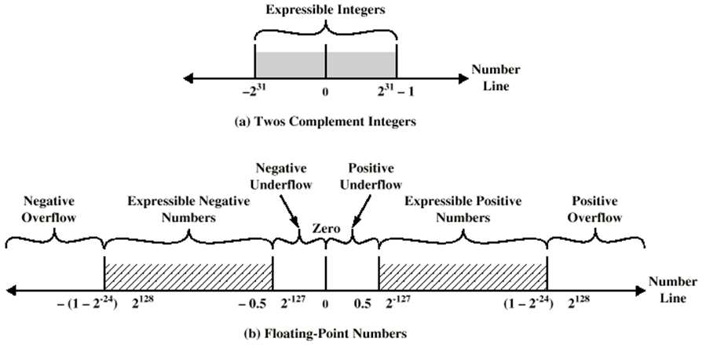
Expressible Numbers

Slide 31
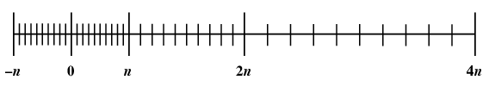
Density of Floating Point Numbers

Slide 32
IEEE 754
Standard for floating point storage
32 and 64 bit standards
8 and 11 bit exponent respectively
Extended formats (both mantissa and exponent) for intermediate results

Slide 33
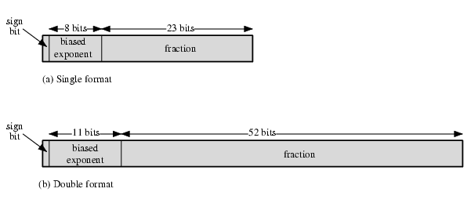
IEEE 754 Formats

Slide 34
FP Arithmetic +/-
Check for zeros
Align significands (adjusting exponents)
Add or subtract significands
Normalize result

Slide 35
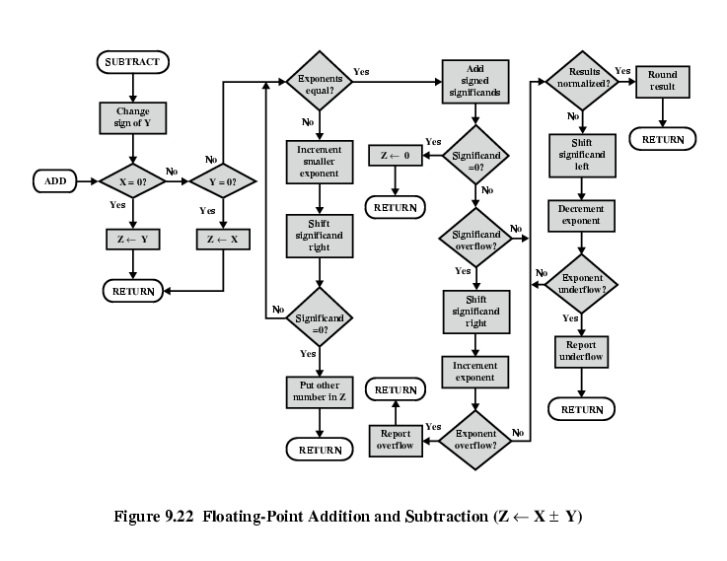
FP Addition & Subtraction Flowchart

Slide 36
FP Arithmetic x/÷
Check for zero
Add/subtract exponents
Multiply/divide significands (watch sign)
Normalize
Round
All intermediate results should be in double length storage

Slide 37
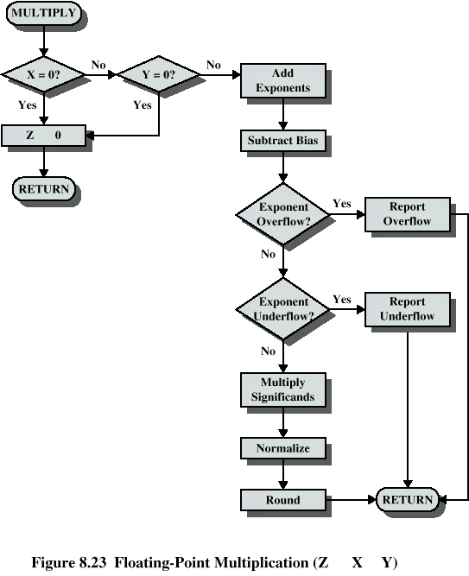
Floating Point Multiplication

Slide 38
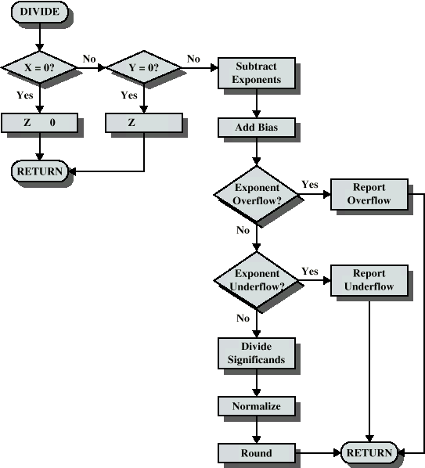
Floating Point Division

Slide 39
Required Reading
William Stallings Chapter 9
IEEE 754 on IEEE Web site

